Slide 1
CREDIT SCORE
A credit scoring model is a risk management tool that assesses the credit worthiness of a loan applicant by estimating her probability of default based on historical data. It uses numerical tools to rank order cases using data integrated into a single value that attempts to measure risk or credit worthiness.

Slide 2
01
Overview of the problem
02
Build input data
03
Data processing & analysis
04
Model building
05
Deployment plan

Slide 3
Overview of problem
1
Introduction of model

Slide 4





Current model problem
80%
Borrowers with no credit history make it difficult to score credit using traditional methods*
Many organizations have used telecommunications data to rank
Viettel, with the great advantage of holding 55% of the telecommunications market share in Vietnam, is able to help millions of Vietnamese people have credit scores, to access capital, and at the same time, help credit institutions reduce risks when Disbursement.
* Theo dữ liệu báo cáo World Bank 2020

Slide 5
Telecom data advantages
Wide coverage, all Viettel subscribers ~ 55% of Vietnam market share
The model-matching data is selected by the algorithm, reducing human subjectivity
Big data size with billions of records per day
Scoring algorithm is mostly machine learning, few assumptions and human intervention
Constantly updated data frequency with low latency
The quality of information is valuable for predicting credit scores, see pages 6 and 11 for details

Slide 6







Overview of problem
Credit rating for customers with unsecured consumer loans. Illustrated model:
Input
Model
Output
Customer score at the date of inclusion in the model
Viettel MSISDN
?
Forecast of customer default probability above the point level
Additional information for verification
Name
Age
Address
Identification
List of Lender's Customers with the corresponding score
Đề xuất danh sách Khách hàng có nhu cầu vay và mức điểm phù hợp

Slide 7
Features Engineering
2
Features Engineering

Slide 8
2. Input data
Input type
Subscriber age
Age
Incoming/outgoing call time
The behavior of using telecommunications
Name
Identify
Amount of data used
Input
Amount to call/text
Gender
Address
Number of incoming/outgoing SMS
Habit of moving
Public relationship
Number of active locations
Contact number
Two-way call number
Number of times to move location
Frequency of locations
Time between two-way calls,...
Number of days Telecommunications use behavior

Slide 9
2. Lấy dữ liệu đầu vào
Mô tả dữ liệu đầu vào
The total number of input variables is 1988 and the model data is updated weekly to ensure continuous model improvement. The problem uses 06 different time points:
During the week (Monday - Friday)
Weekend (Saturday - Sunday)
Working (7h30 - 17h00)
Rest (17:00 - 23:00)
Night (23h00 - 7h30)
Working (7h30 - 17h00)
Rest (17:00 - 23:00)
Night (23h00 - 7h30)
All variables containing telecommunications data are aggregated according to these 06 milestones to best distinguish customer behavioral characteristics.
Data are extracted for 6 consecutive months: The increase in observation time is to enhance the stability of the observations and to see more clearly the trend of using telecommunications equipment of subscribers. In addition, this also contributes to partially preventing new junk sims from operating.

Slide 10
2. Input data
Identity data
Age of customers: Age distribution is correlated with bad debt ratio (details on page 21)
Subscriber age: The older the subscriber, the more reliable it is, limiting the possibility of spam sims
Full name: Check the completeness of subscriber information
Subscriber's registered address: Regionality can also affect bad debt ratio (see page 22)
Gender: Usually, women have a lower bad debt ratio than men
A subscriber with complete, unambiguous identity information will usually have more confidence

Slide 11
2. Input data
Behavioral data of telecommunications use
Data Mobile phone
ARPU
Call/SMS
Total amount of data used.
Total amount of data uploaded
Total amount of downloaded data
Daily upload data volatility.
Variation of download data by day
Total amount used
Total amount for call
Total amount for sms
Total amount for data
VAS
Number of advances
Total amount of advance
Subscriber status: Before, after
Number of times to change subscription status.
Total time of incoming/outgoing calls/sms, missed calls
Variation of outgoing and incoming calls
Frequency of calling/texting
Number of missed calls
Number of days subscribed to telecommunication activities
These data show the financial ability of the subscriber, the level of payment of the subscriber for telecommunications activities such as a full-paying and non-advanced phone subscription usually has a lower probability of default than the Other subscribers or postpaid subscribers usually have a better level of reliability than prepaid subscribers.

Slide 12
Data processing & analysis
3
Data processing & analysis

Slide 13
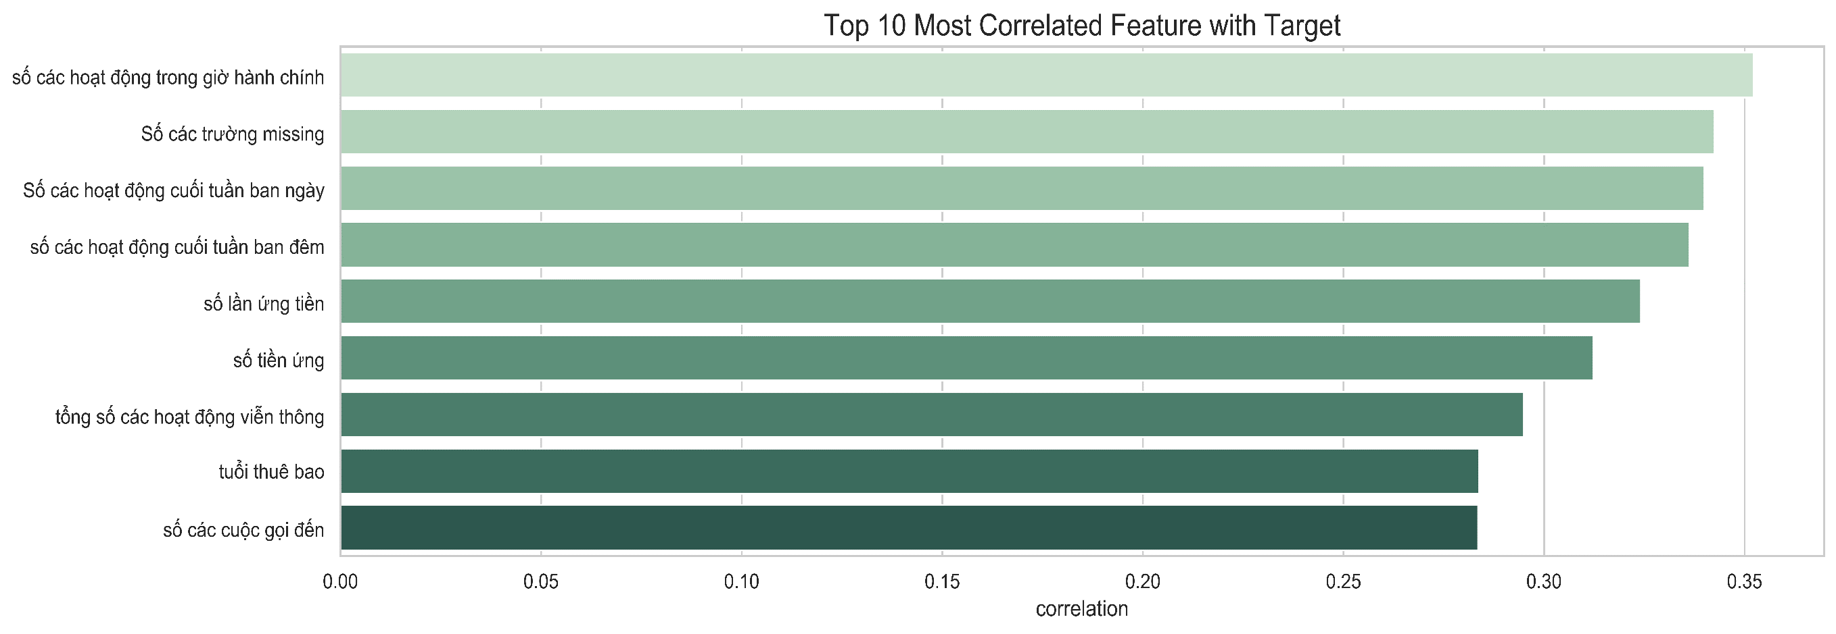
Correlation check
The top 10 variables that are best correlated with bad/good debt labels have coefficients ranging from 0.28 to 0.35. It can be seen that these fields have a pretty good linear relationship with bad/good debt labels.

Slide 14
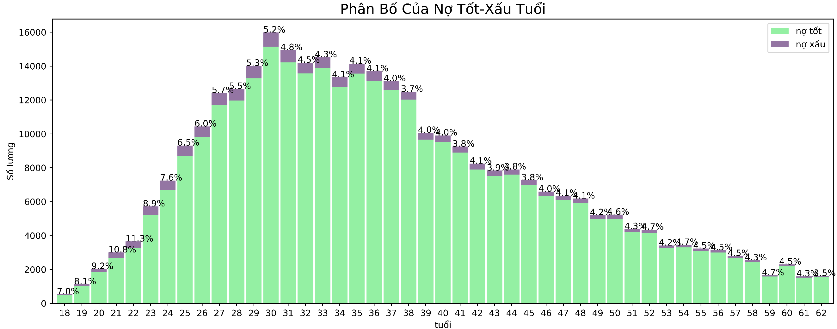
Distribution of variable values
The bad debt ratio is high in the age group under 32 and much lower in the other group.

Slide 15
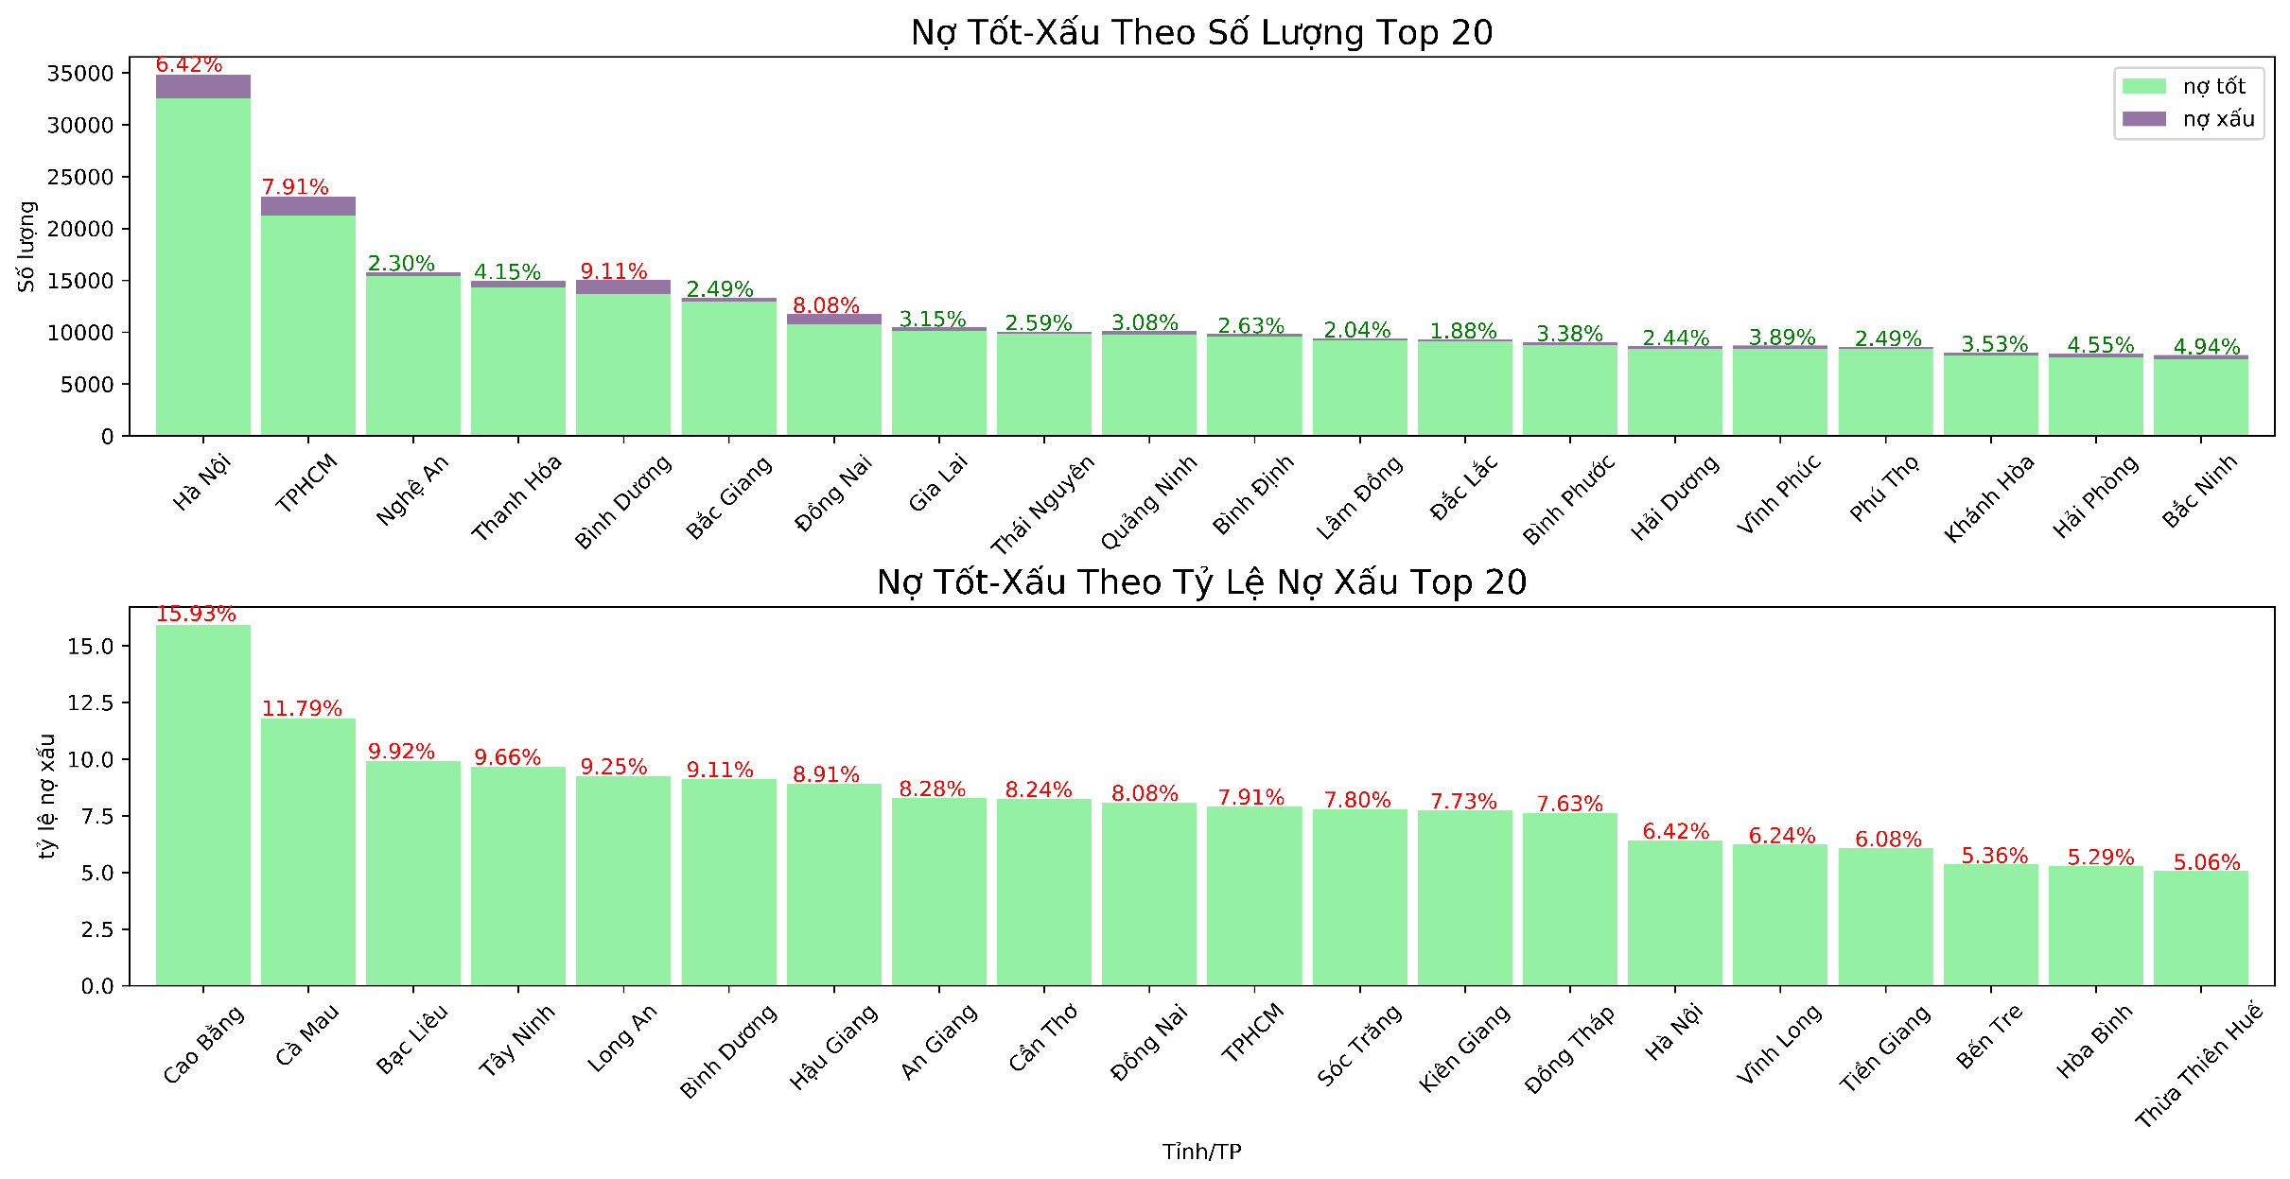
Distribution of variable values
Borrowing subscribers are distributed widely in big cities/provinces such as Hanoi, Ho Chi Minh City, Nghe An, Thanh Hoa, in which Hanoi, HCM, Binh Duong, Dong Nai have high bad debt ratio. mutation.
The provinces of Cao Bang, Ca Mau, Bac Lieu,... ranked in the top of bad debt, but the number of observations is low, the reliability is not high.

Slide 16
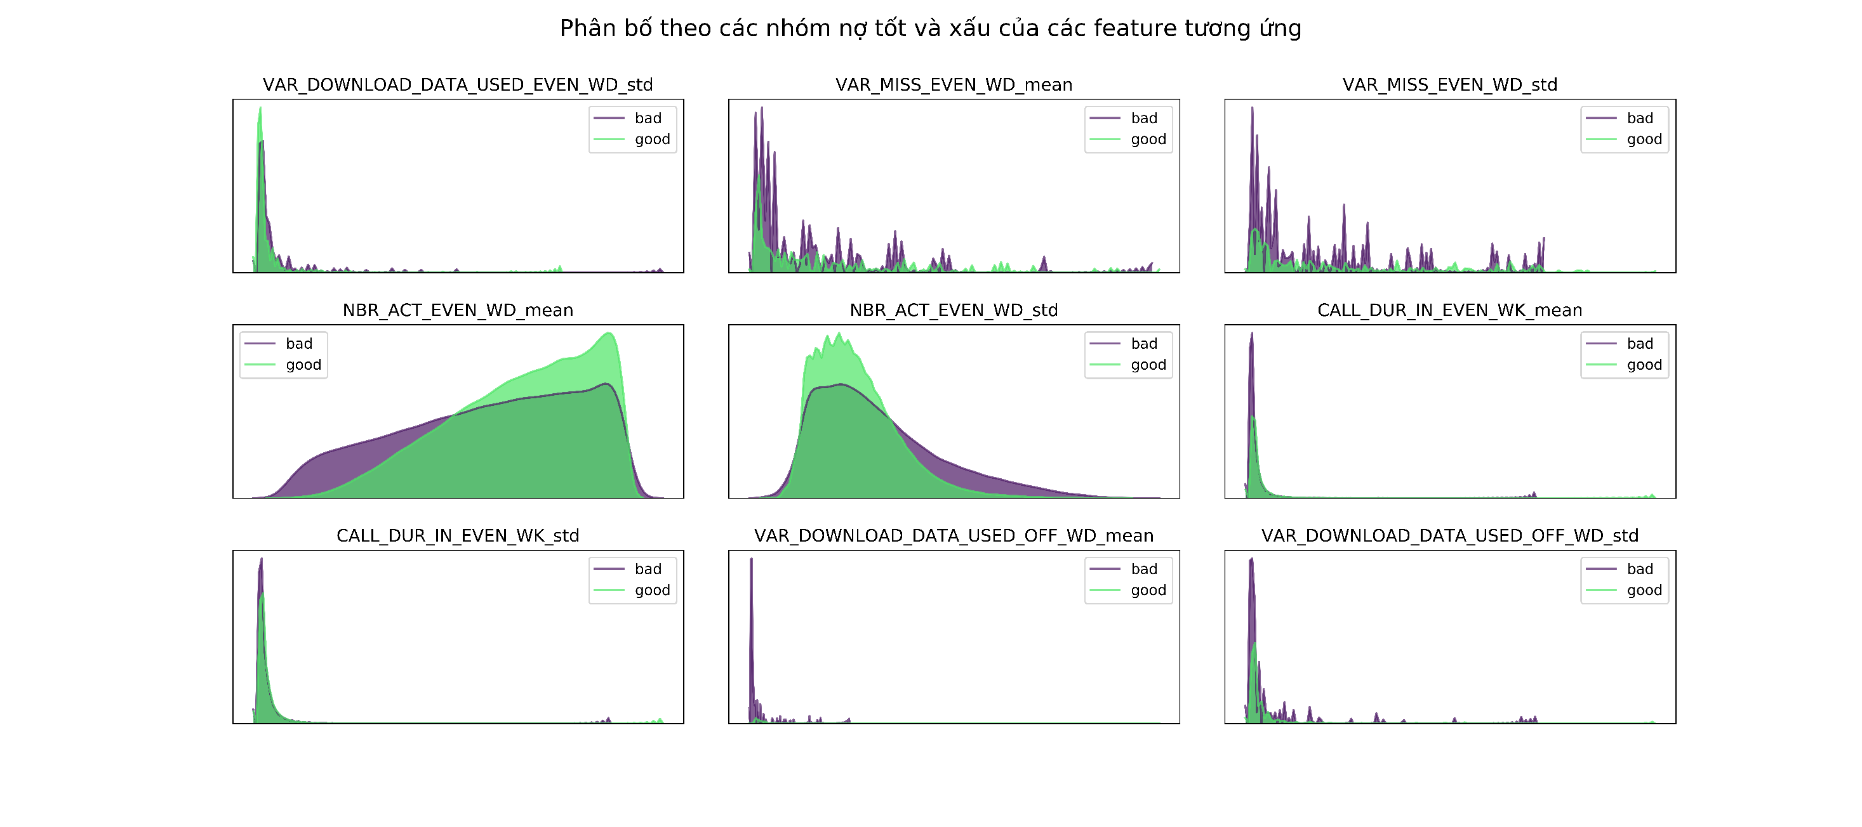
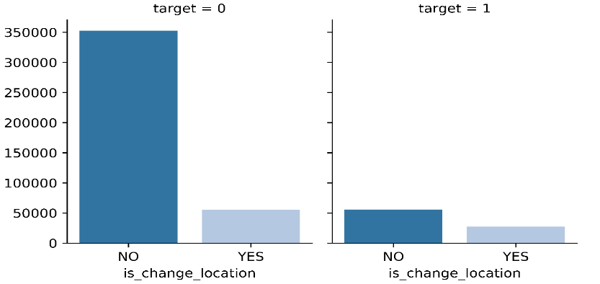
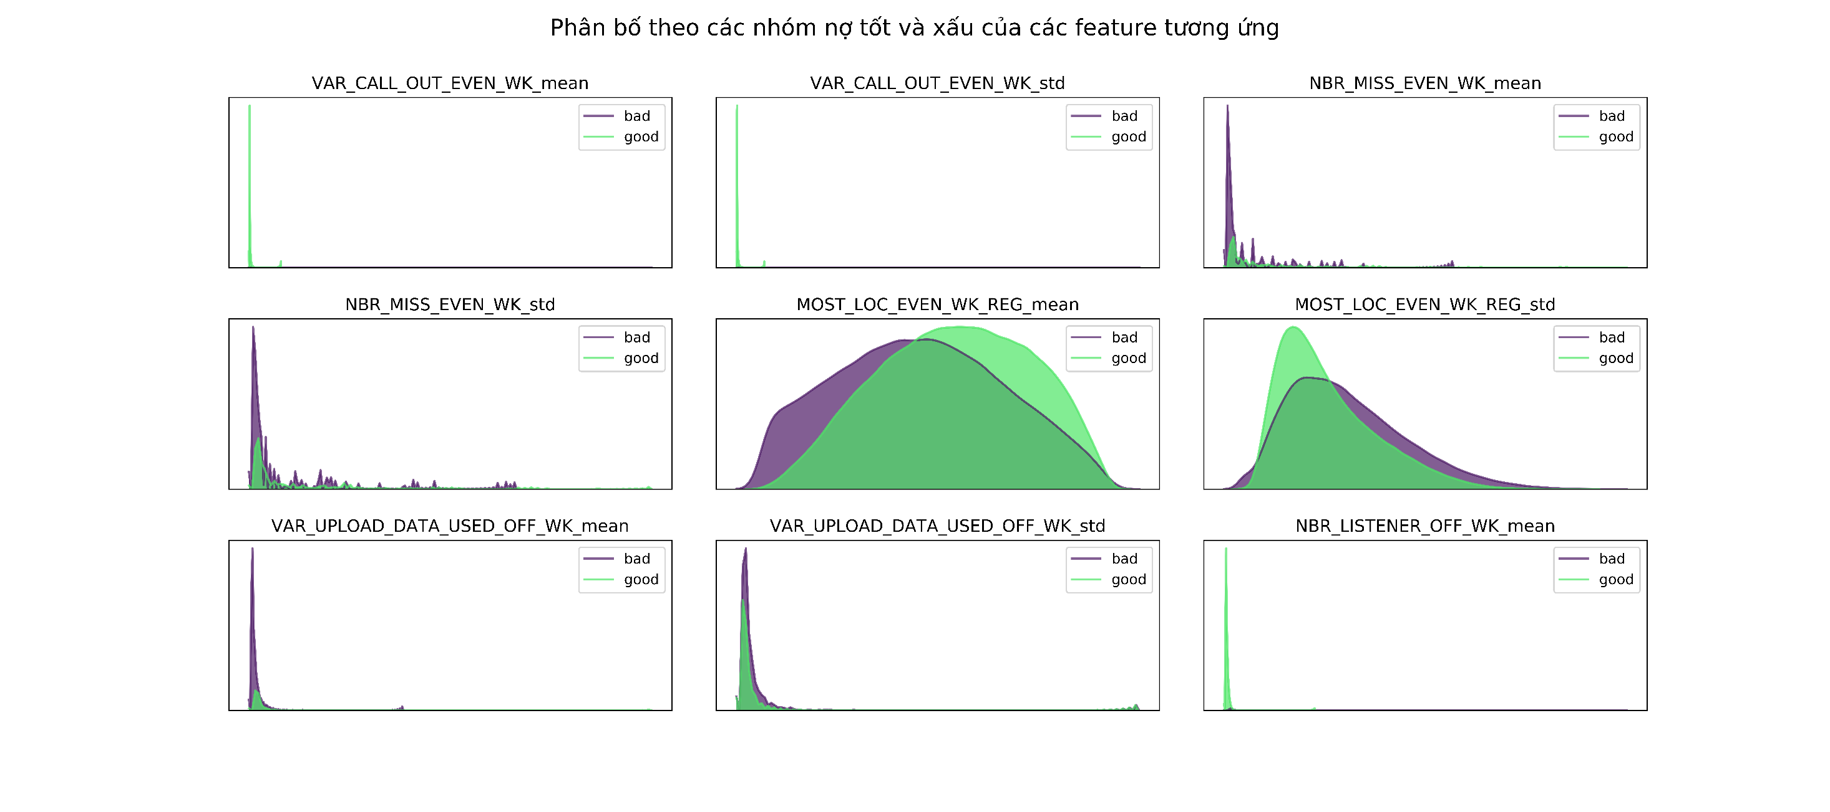
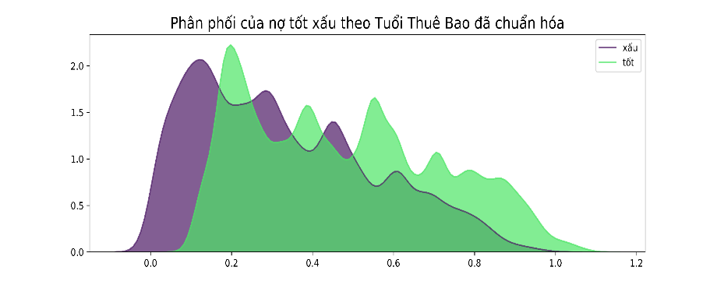
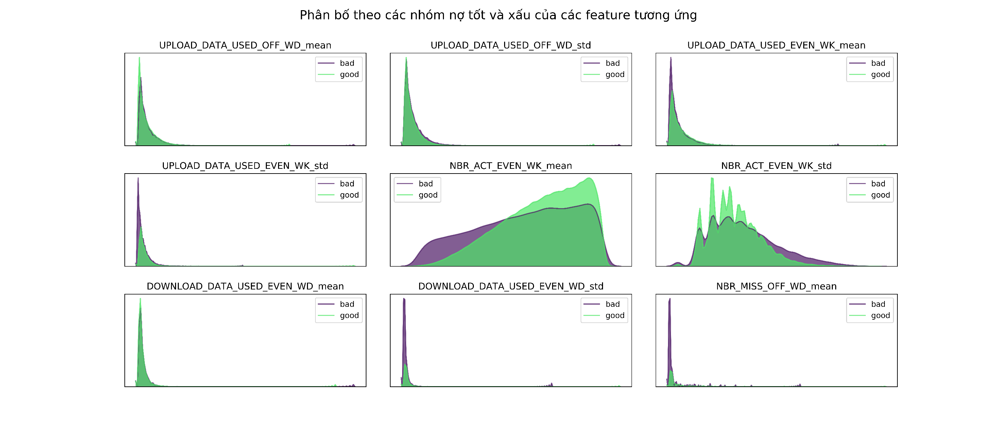
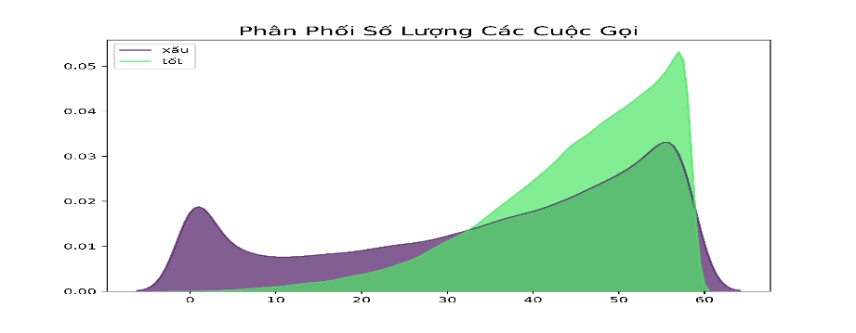
Distribution of variable
Distributing Subscribers At least 01 Time
Change of Work Location
Average Distribution of Telecommunications Days in the Evening of the Week
Analysis of some important variables found that the distribution of values is discriminatory in terms of good and bad credit
Average Distribution Of Frequency To The Most Popular Locations Evenings & Weekends
Telecommunications Subscriber Age Distribution (Varied Normalization)
Distribution of variable values
Telecommunications data has the ability to give credit ratings to subscribers
Average Distribution of Days Telecommunications Usage In The Evenings & Weekends
Distribution of Number of Calls/Month of Subscribers
Nợ xấu
Nợ tốt

Slide 17
Data selection mindset
Data generation thinking will be in the direction of maximizing exploitable information, including three steps: creating basic data (raw data), exploiting information fields from basic data (Features extraction), using transformation techniques for generating secondary data (feature extraction).
Features extraction
Features extraction
Public relationship
Variance test
Habit of moving
Chi-squared test
Location
Correlation test
Telecom Usage
Regression test
458 data fields:
Extract from schools of information and thinking from prestigious research articles
1988 data fields:
Using encoding techniques (max, min, median, mean, entropy,...)
The data is not valid for scoring, will be excluded during processing & cleaning, or selected by the model itself.

Slide 18
Credit Score Model
4
Data modelling

Slide 19
Model flow overview
Pipeline Storage System
Prepare Data
Train Model
Deploy Model
Monitor Model
Features Extraction
Data Preparation
Model Training & Validation
Model Deployment
Inference
Explore data
Model Selection
Intergrate into system
Tracking performance
Missing cleaning
Data Storage
Outlier cleaning
Hyper-parameter
Tuning
Batch Scoring
New real-life data
Label Encoding
Model testing
Normalization
- Set rules to knock-out records
- Report data processing step by step
- Usually store versions of model
- Daily track performance of model
- Store history of customer scoring
- Track data updates in database

Slide 20
ML Algorithm selection
Support Vector Machine
K-Nearest Neighbors
Run different models to choose the best ML Algorithm.
Logistic Regression
Neural Networks
Tree-Based Models
Naïve Bayes
Simple algorithms like Logistic Regression or Naïve Bayes are used as baselines.
For each algorithm, run baysian research CV to find the parameter set that best fits that model

Slide 21
ML Algorithm selection
Support Vector Machine
Based on the strengths of each model and expert experience
Dựa trên hiệu quả mô hình trong thực tế
Logistic Regression
Neural Networks
Boosting algorithms in the line of Tree-Based models such as LightGBM, XGBoost, CatBoost math always achieve the best results with classification problems.*
The LightGBM algorithm was selected to build the model
Tree-Based Models
LightGBM
CatBoost
XGBoost
Decision Tree
* According to the papers referenced in the appendix
Random Forest
Basically, the algorithms Random Forest, LightGBM, XGBoost, CatBoost are the same, belong to the same family of boosting algorithms: Use many weak Tree Decisions to create a Robust Decision and limit overfitting.

Slide 22
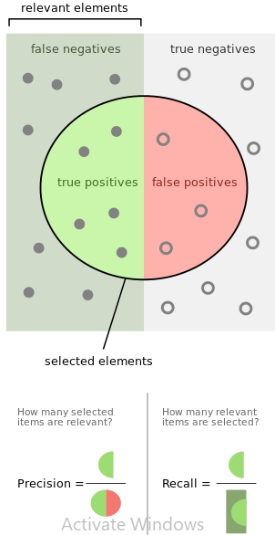
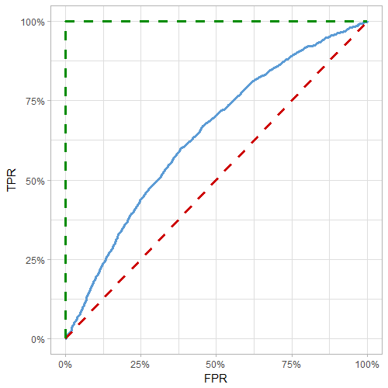
Criteria for measuring results
Gini: This value ranges from -1 to 1, corresponding to completely wrong guess and absolute right.
Recall: The ratio of correct prediction of bad labels to total number of bad labels.
- Tỷ lệ đoán đúng nợ xấu
Dự báo chính xác lý tưởng
Gini/2
Dự báo mô hình
Dự báo ngẫu nhiên
- Tỷ lệ đoán nhầm nợ tốt thành nợ xấu
https://en.wikipedia.org/wiki/Precision_and_recall

Slide 23
Prediction Results
Gini = 0.72 mean error 0.01.
Balanced accuracy = 73.49 % average error 0.06%
Recall score = 79.21% mean error 0.04%
 | Bad MSISDN Prediction | Good MSIDN Prediction | Total
Actual bad MSISDN | 16,483 | 4,327 | 20.810
Actual good MSISNG | 211,030 | 443,801 | 654.831
Total | 227.513 | 448.128 | 675.641
The structure of the confusion matrix can be changed by changing the model threshold for good/bad debt to better suit each situation:
Minimize bad debt: In case we don't have a lot of capital, or have a low risk appetite, it will lower the high threshold, but the limitation is that there are many good debts that are not considered for loans due to strict standards.
Increase disbursement rate: In case we have abundant capital, and high risk appetite, consider a low threshold but the limitation is that the bad debt ratio is likely to increase.

Slide 24
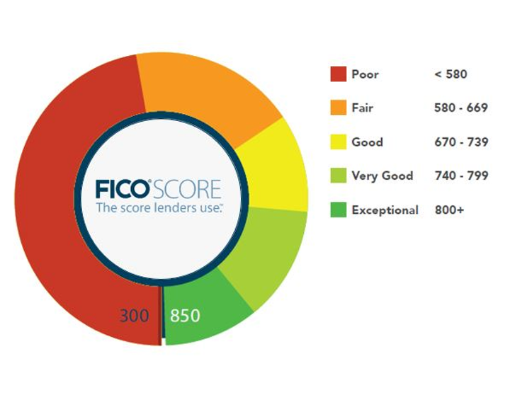
=
Compare model score spectrum
The forecast model provides a threshold of customer credit rating according to FICO standard (300 – 850) with 05 levels:
The spectral distribution predicted by the telecommunications model has many similarities with the point spectrum distribution of the FICO* system, showing the reliability of the model.
* Truy cập đường link xem thêm về tính phổ biến của hệ thống FICO

Slide 25
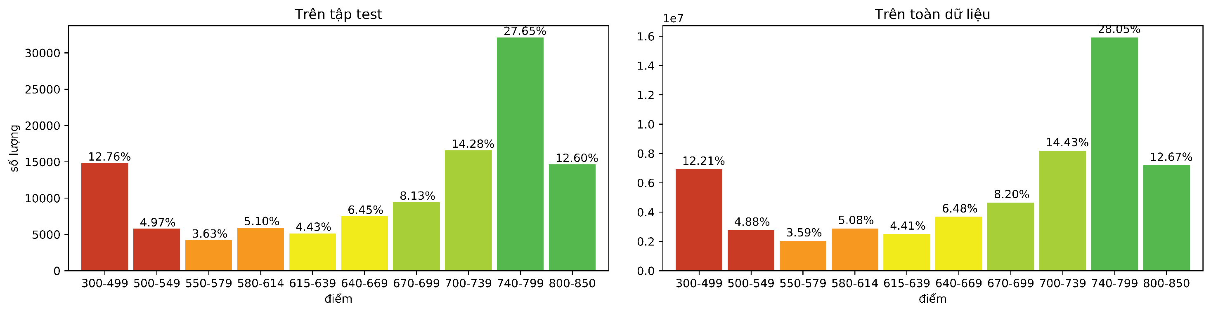
Compare model score spectrum
The forecast model provides the distribution of model scores on the entire data set of Viettel's telecommunications customers
Đơn vị: Chục triệu người

Slide 26
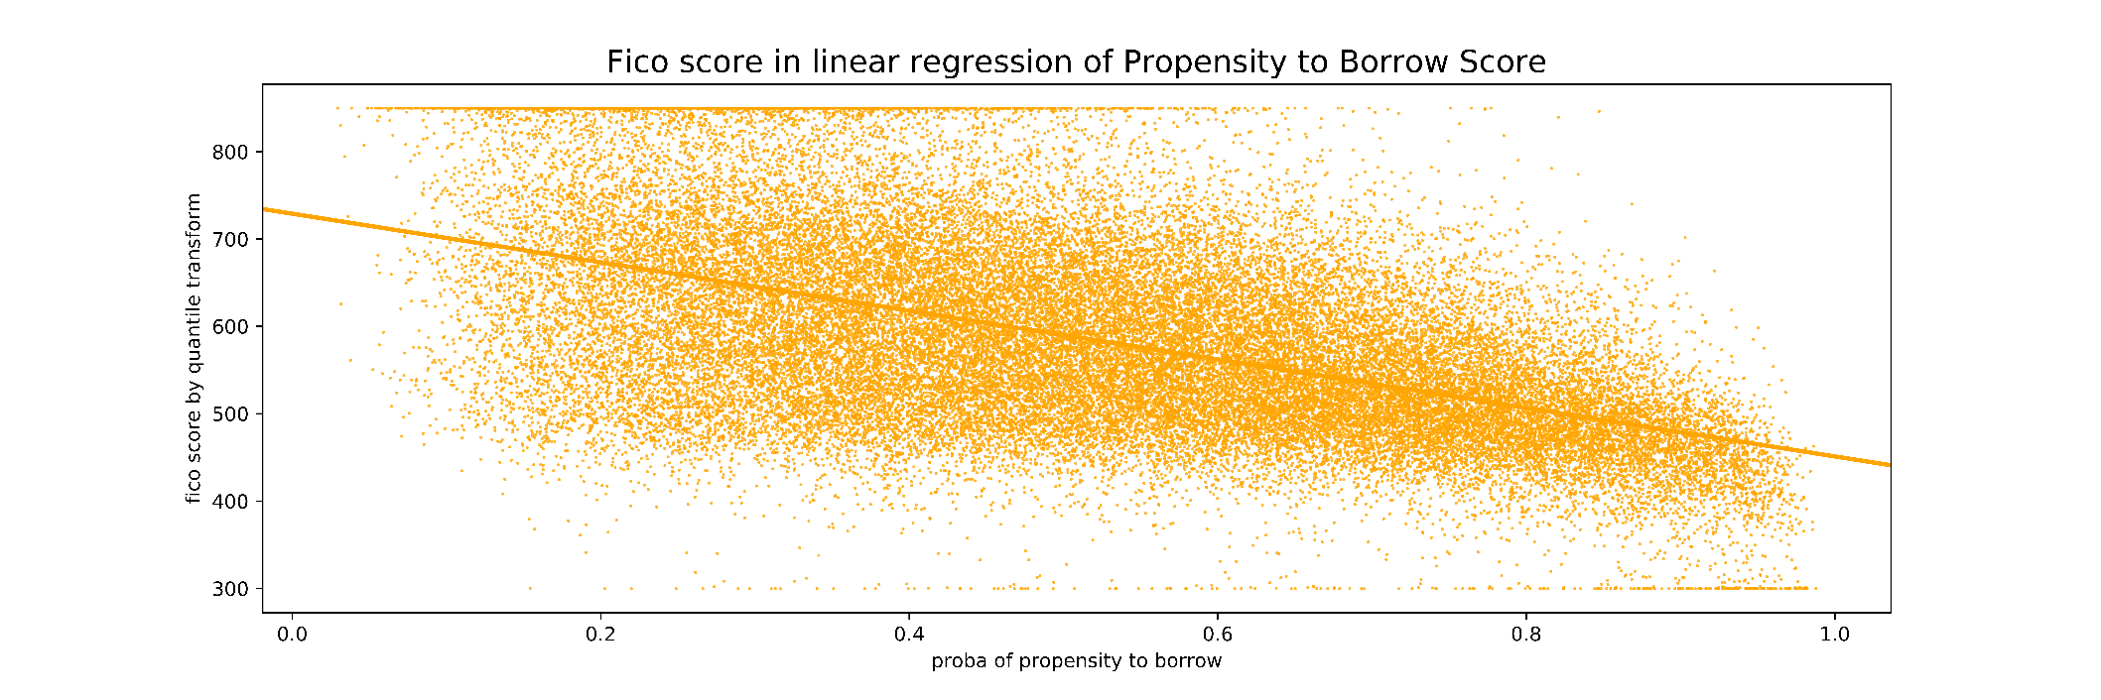
Result of loan demand score
Preliminary results of the model to forecast demand for borrowing (propensity to borrow). We see that these two points are inversely proportional, proving that subscribers with high Fico scores often have low borrowing needs and vice versa.
Past Application: Running lead sets for EasyVay, SaveNow, Vietlott products
The next step could be using a multi-product support model for marketing.
* Hai mô hình đang trong quá trình phát triển để hoàn thiện bộ sản phẩm chấm điểm

Slide 27
Reference studies
Lane, M., Carpenter, L., Whitted, T., Blinn, J.: Scan line methods for displaying parametrically defined surfaces. Communications ACM 23(1) (1980)
Ding, C.H.Q., Peng, H.: Minimum redundancy dữ liệu selection from microarray gene expression data. J. Bioinformatics and Comp. Biol. 3(2) (2005) 185–206
Prediction of Socioeconomic Levels Using Cell Phone Records
Credit Scoring for Good Enhancing Financial Inclusion with Smart(2019)
Business Intelligence Applications and Data Mining Methods in Telecommunications: A Literature Review https://core.ac.uk/tải xuống/pdf/71542208.pdf
And many other at: http://confluence.digital.vn/x/ZyRDAg

Slide 28
Notes
Using data for 5 months instead of 3 months can add up to about 0.03 gini index. The author proposes to use data for 6 consecutive months to increase stability.
Standard dropout from the model: Subscribers have at least 1 month without incurring telecommunications transactions. When running in reality, it is possible to issue a minimum score for subscribers who have interrupted telecommunication transactions (incurred in month t but not in month t+1)
With numeric data: Group into groups according to different months, turn into mean and std data of these data. These actions increased the gini index by about 0.015 compared to using the original data.
For data categoricals: Encoder with label encoder normally. In the author's experience, encoder by other methods such as onehotencoder, target encoder does not improve accuracy if boosting algorithm is used.

Slide 29
ML Algorithms Advantages
Advantages of LightGBM
Advantages of K-folds*
Low resource consumption, easy to run on Hadoop Spark (server) or personal machine (local).
Good results on many different datasets with very few parameter settings.
Good limitation of overfitting problem.
Easily deal with missing data, non-numeric data, and mislabelling.
Applying K-Folds next to LightGBM aims to give the most objective and stable results
Minimize the confounding factors caused by the process of cutting the training and test sets.
Method: Randomly divide the data set into 5 equal parts. Train on 4 parts in turn and test the results on the remaining set
* Chi tiết kết quả chạy K-fold xem phần phụ lục

Slide 30
Model point distribution
The forecast model provides the distribution of model scores on the entire data set of Viettel's telecommunications customers

Slide 31
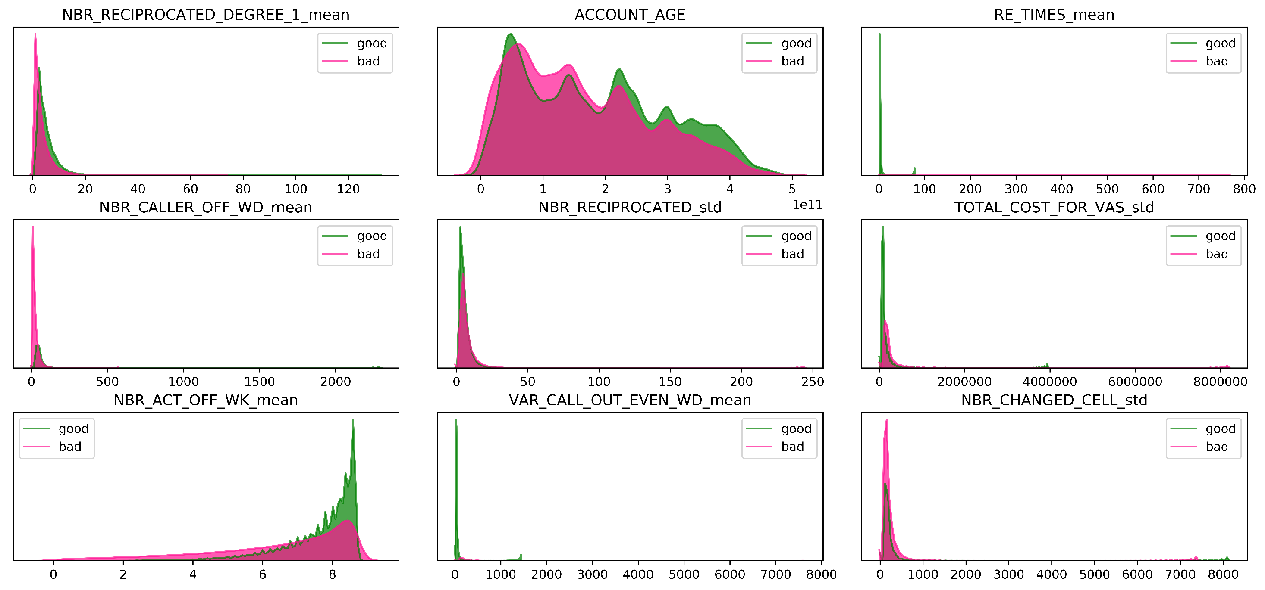
Distribution of variables

Slide 32
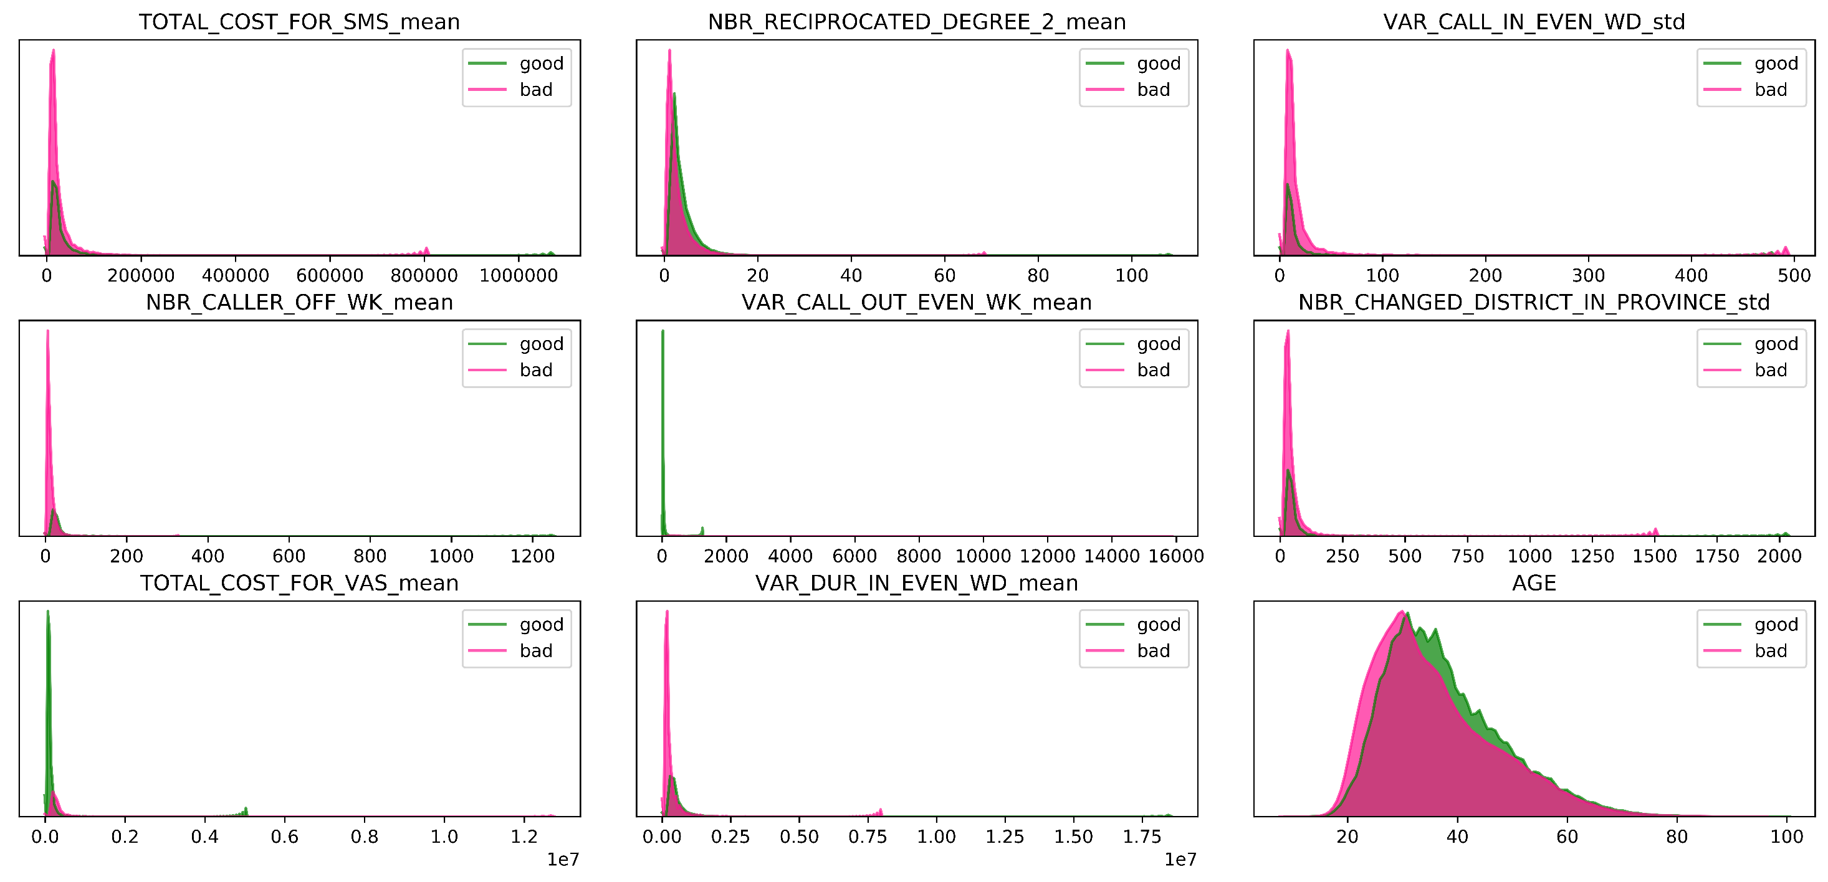
Distribution of variables

Slide 33
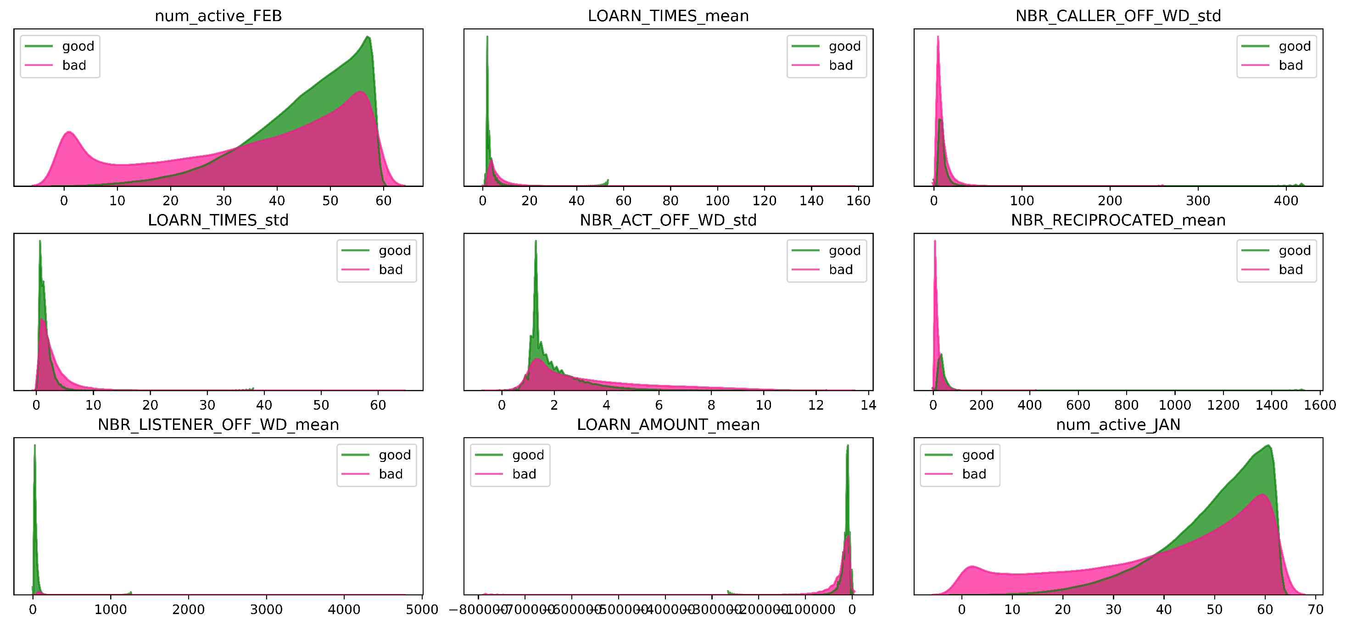
Distribution of variables

Slide 34
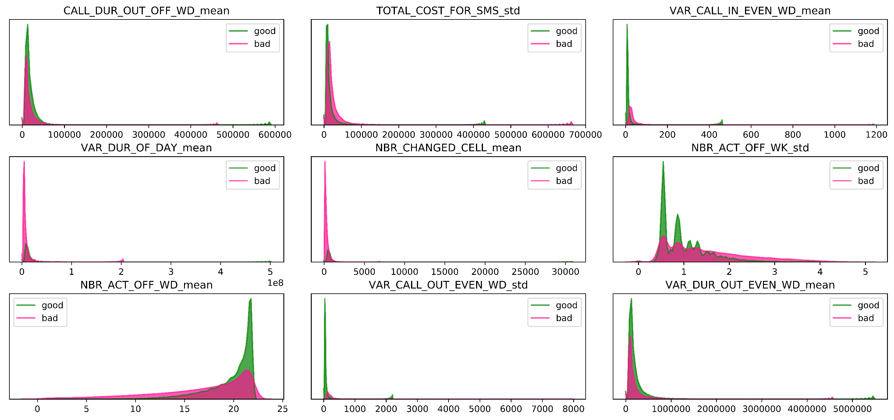
Distribution of variables

Slide 35
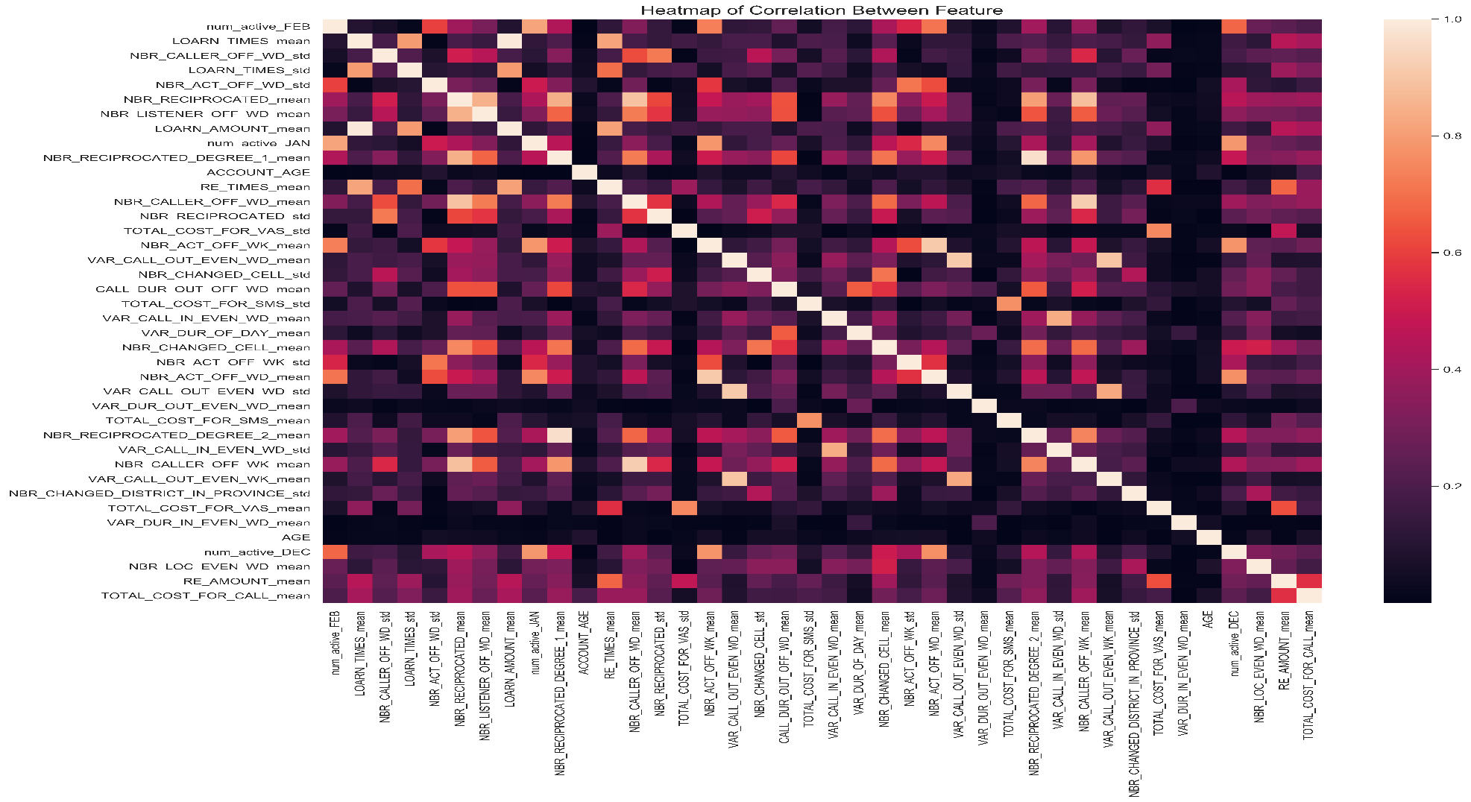
Correlation coefficient heatmap

Slide 36
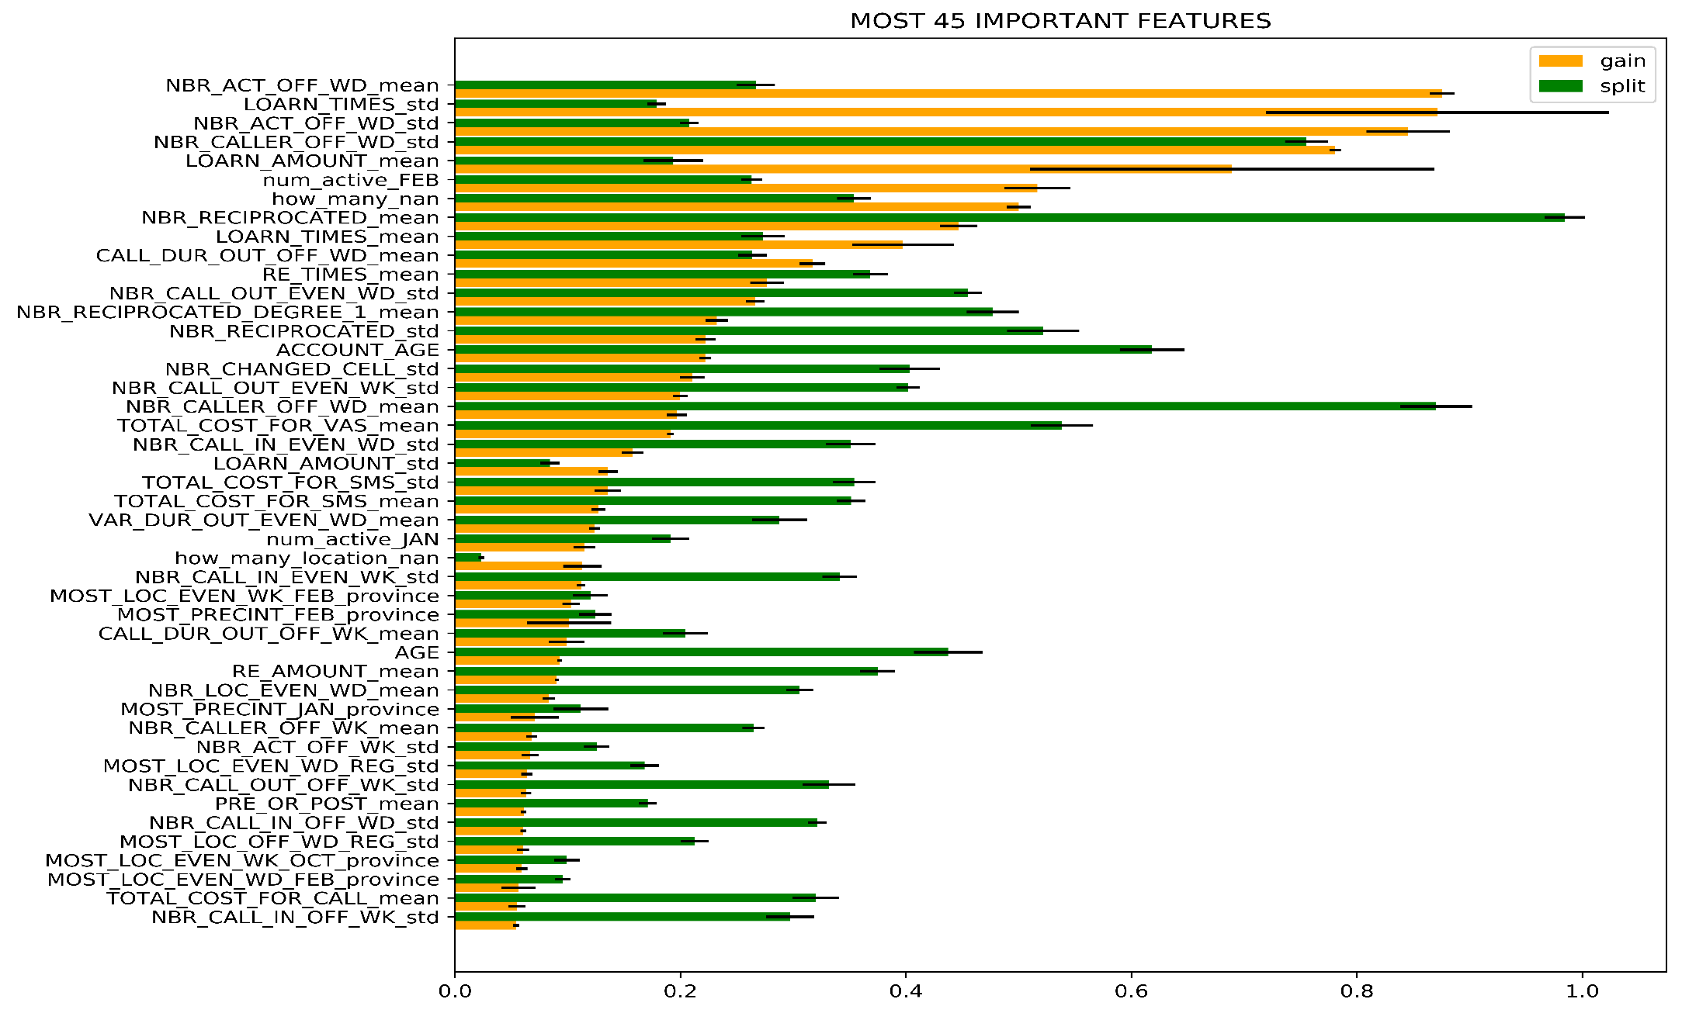
Result evaluation
The model's plausibility is partially reflected in the Top of the Most Important Lists. Here we have:
Group data related to call frequency during office hours.
Group of data related to the frequency of telecommunications advances.
Groups are concerned with the subscriber's two-way interactions.

Slide 37
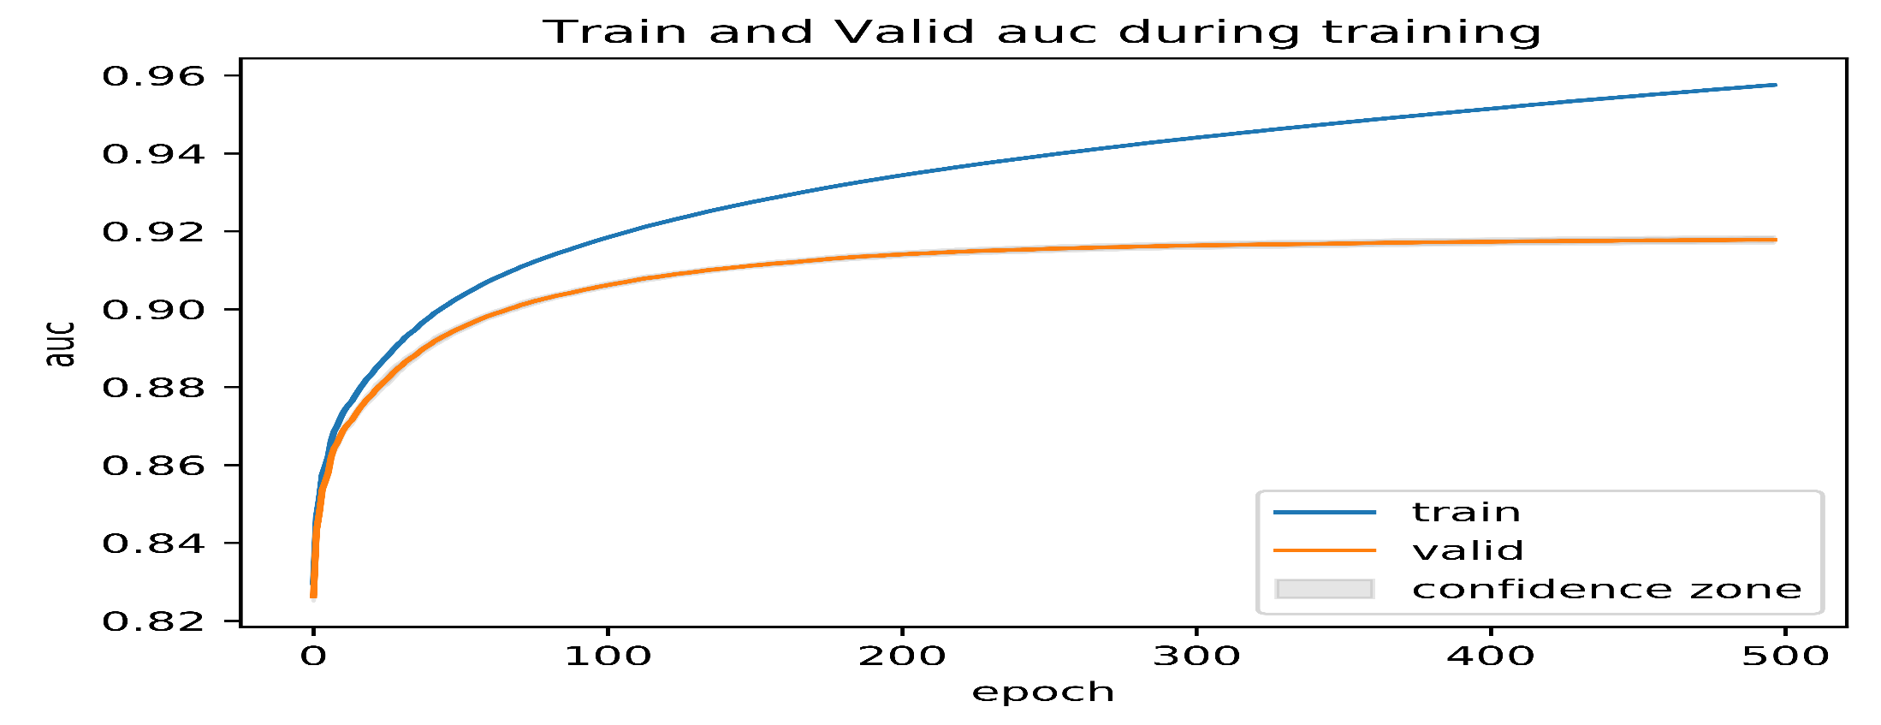
Result evaluation
The models performed on different train and test sets all give very small standard deviation results, proving the very high stability of these models, because the dataset is large enough.

